Slide 1

Introduction to GenAI Fundamentals

Slide 2
Overview of GenAI

Slide 3
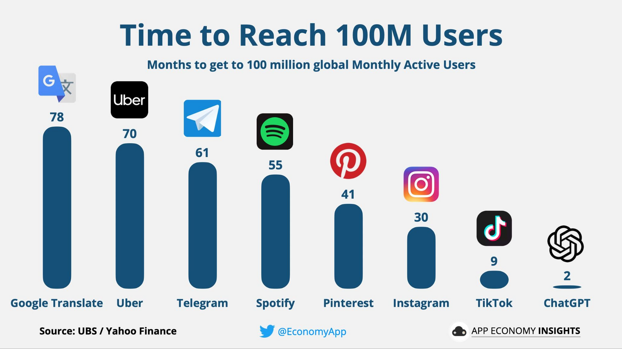
Generative AI
Notes:
It took just 2 months for ChatGPT to reach 100M users. Whereas, google translate took 78 months to reach so. Thats the popularity and power of Generative AI

Slide 4
Generative AI
A subset of Artificial Intelligence (AI)
Enables machines to generate new, original content
Uses machine learning algorithms to create novel outputs
Can generate text, images, music, and more
Trained on large datasets to learn patterns and relationships
Notes:
it's a type of AI that enables machines to generate new, original content. This can be anything from text to images to music, and it's all made possible by machine learning algorithms and large datasets

Slide 5
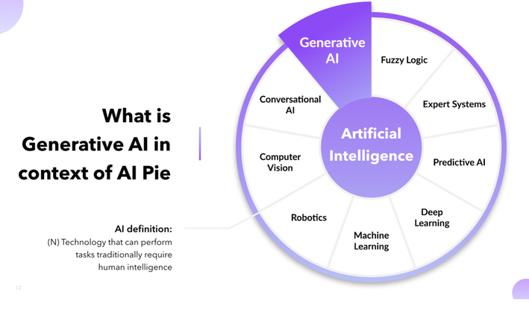
Generative AI
Notes:
Generative AI can be seen as a part of the AI pie

Slide 6
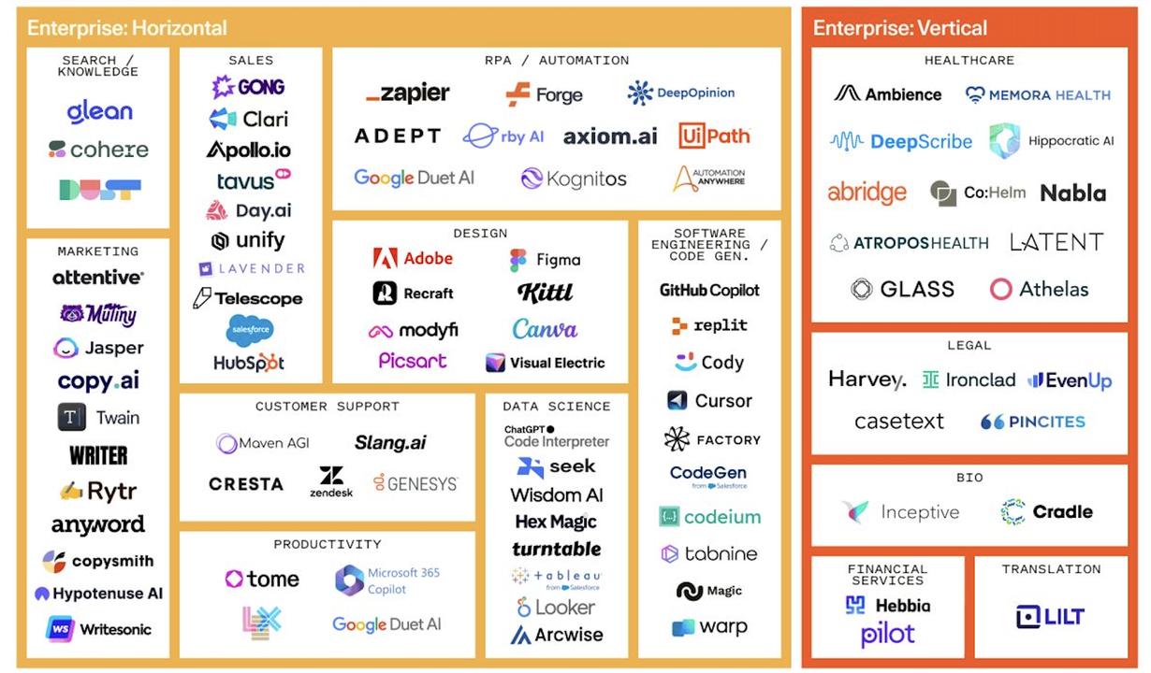
Generative AI
Notes:
We can categorize and view the Generative AI companies horizontally and vertically. Horizontally domain wise is viewed. Vertically area wise is categorized.

Slide 7
Evolution of Gen AI
Rule-Based Systems
Early AI systems relied on predefined rules and logic to perform tasks
Machine Learning Era
Advancements led to the development of machine learning algorithms capable of learning from data
Generative AI Emergence
Generative AI represents the latest phase, enabling machines to generate new content autonomously
Notes:
Rule-Based Systems: These were the early stages of AI, where systems operated based on predefined rules and logic. They lacked adaptability and learning capabilities, limiting their functionality to specific tasks and scenarios.
Machine Learning Era: The evolution of machine learning brought about a significant shift in AI capabilities. Machine learning algorithms enabled systems to learn from data, recognize patterns, and make predictions or decisions without explicit programming for every scenario.
Generative AI Emergence: The latest phase in AI evolution is Generative AI, characterized by models that can generate new content autonomously. This represents a leap from traditional machine learning towards systems capable of creativity and autonomous content creation.

Slide 8
Types of GenAI
Text-to-Text: generating human-like text
Text-to-Image: generating images from text descriptions
Image-to-Image: generating new images from existing ones
Music and Audio: generating music and audio files
Video Generation: generating videos from scripts or prompts
Notes:
From generating human-like text to creating new images and music, the possibilities are endless. Each type of GenAI has its own unique applications and use cases.

Slide 9
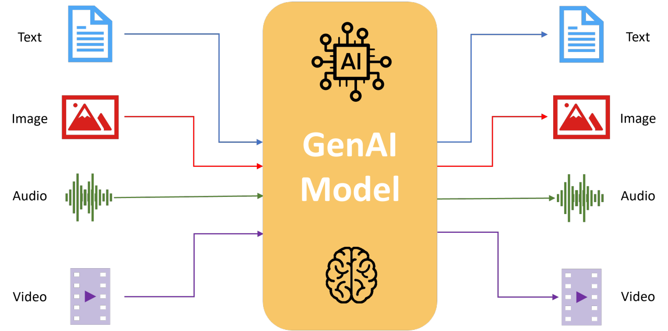
Types of GenAI
Notes:
Figure illustrates the same

Slide 10
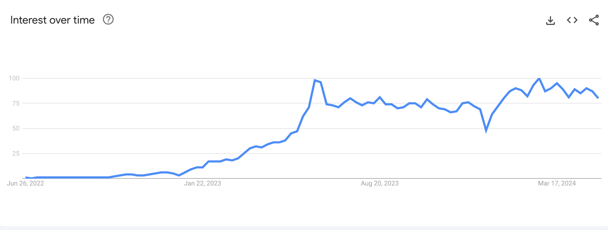
Interest on Generative AI topic
Notes:
As shown in google trends, Interest on Generative AI topic has increased over time

Slide 11
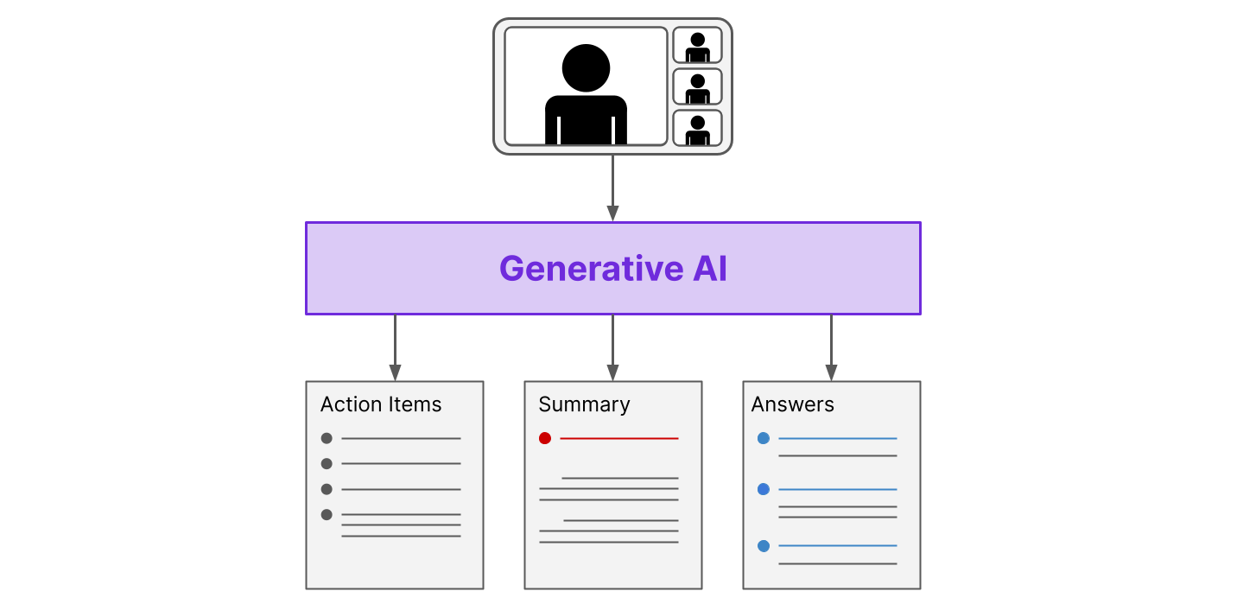
Use cases of Generative AI
Notes:
Generative AI can be used to automatically generate useful documents during or after a meeting

Slide 12
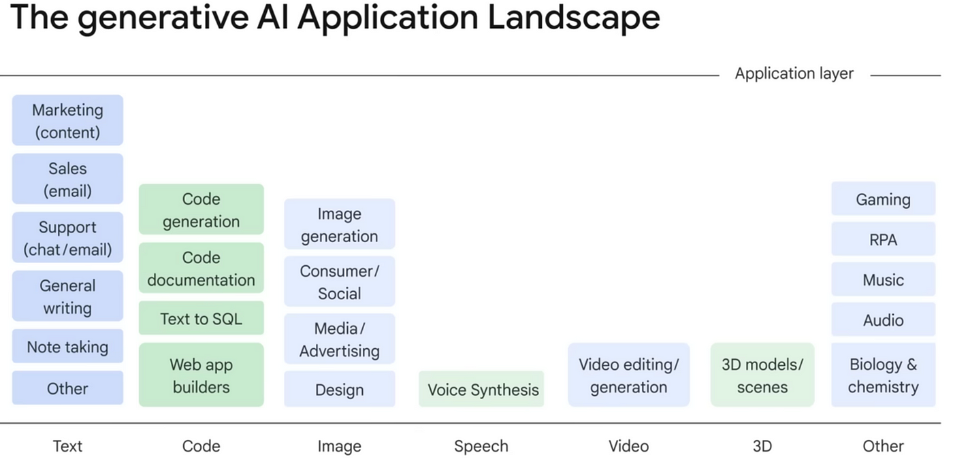
Notes:
The application layer of a generative AI application landscape encompasses various functionalities that leverage generative AI. Within this application layer, there are different content types that generative AI can be used for. These content types include creative applications like design and voice synthesis, code generation for developers, tools for marketing and sales teams, and functionalities like note-taking and generating text-based queries.

Slide 13
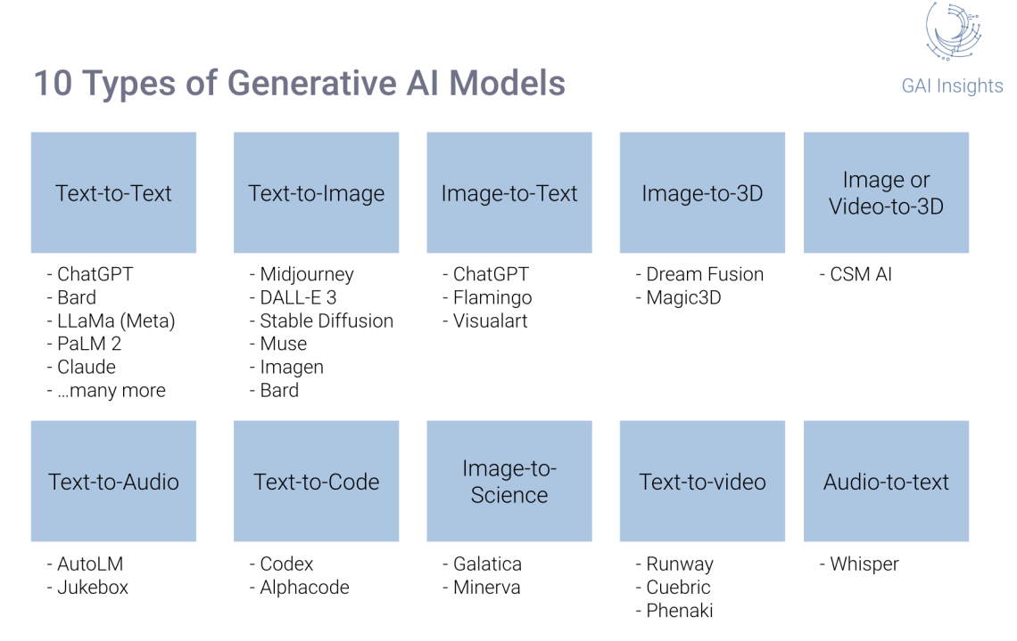
Top 10 Generative AI Models
Notes:
The image lists various generative AI models categorized by the type of data they process and generate. Here are ten generative AI models listed across various categories:
Text-to-Text: ChatGPT, Bard, LaMDA (Meta)
Text-to-Image: Midjourney, DALL-E 3, Stable Diffusion
Image-to-Text: ChatGPT, Flamingo
Image-to-3D: Dream Fusion, Magic3D
Text-to-Code: Codex, Alphacode
Text-to-Audio: AutoLM, Jukebox
Audio-to-Text: Whisper

Slide 14
Difference between AI and Generative AI

Slide 15
Traditional AI Working
Traditional AI relies on explicitly programmed rules and instructions
Developers feed the AI with specific data sets and algorithms to perform tasks
Analyze data, identify patterns, and make predictions based on the programmed logic.
Notes:
Traditional AI operates in a very structured manner. Think of it as a highly skilled but rule-abiding assistant. We provide it with clear instructions, data sets, and algorithms, and it executes tasks with precision. For example, a traditional AI program might analyze historical sales data to predict future demand for a particular product. It excels at tasks with well-defined rules and readily available data.text to creating new images and music, the possibilities are endless. Each type of GenAI has its own unique applications and use cases.

Slide 16
Strengths of Traditional AI
Accuracy
Efficiency
Reliability
Notes:
Traditional AI shines in situations where accuracy, efficiency, and reliability are paramount. Imagine a chess-playing AI that can analyze millions of possible moves in a fraction of a second. Or, consider a product recommendation engine that flawlessly tailors suggestions to your past purchases. These are just a few examples of how traditional AI brings automation and accuracy to the table.

Slide 17
Limitations of Traditional AI
Limited Adaptability
Lack of Creativity
Data Dependency
Notes:
While traditional AI is a powerful tool, it has its limitations. If you throw a curveball or present a new scenario, it might struggle to adapt. Additionally, traditional AI lacks the creativity to generate entirely new concepts. Finally, the quality of traditional AI's output is highly dependent on the data it's trained on.

Slide 18
Generative AI
Focus on creativity and innovation
Ability to learn from data and adapt
Potential to revolutionize industries
Notes:
Generative AI is all about creativity, innovation, and adaptability. It has the potential to revolutionize industries and transform the way we live and work.

Slide 19
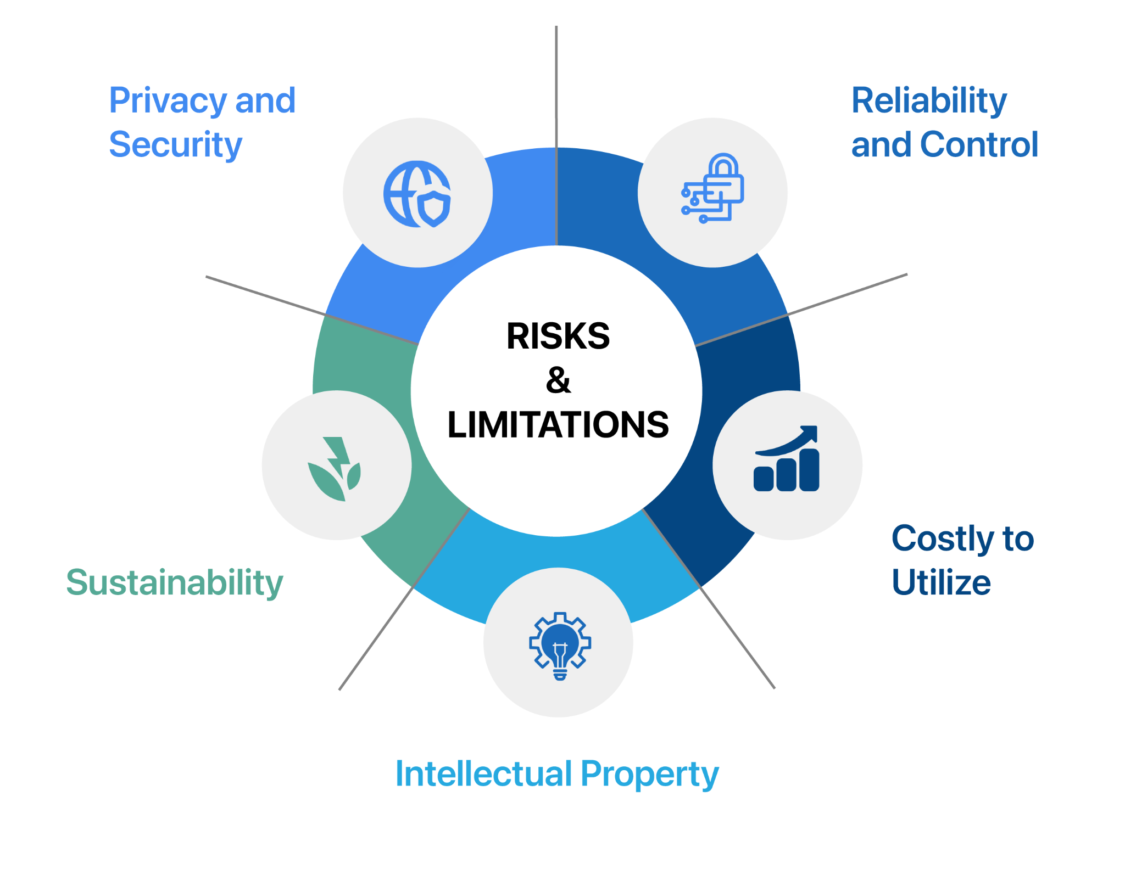
Limitations of Generative AI
Notes:
some limitations of generative AI are:
Privacy and Security: Generative AI models can be trained on vast amounts of data, which may raise privacy concerns. Additionally, these models can be used to create deepfakes or other forms of synthetic media that could be used for malicious purposes.
Reliability and Control: Generative AI models are complex and can sometimes produce outputs that are unexpected or even unsafe. It can be difficult to ensure that these models are reliable and consistent, and it can be challenging to control the creative process.
Sustainability: Training generative AI models can require a significant amount of computing power, which can have an environmental impact.
Costly to Utilize: The computational resources required to train and run generative AI models can be expensive.
Intellectual Property: There are concerns that generative AI models could be used to create derivative works that infringe on copyright or other intellectual property rights.

Slide 20
Algorithms under Traditional AI
Decision Trees
Support Vector Machines (SVMs)
Logistic Regression
K-Nearest Neighbors (KNN)
Notes:
Traditional AI has been the workhorse of automation for decades. These models excel at tasks with well-defined rules and readily available data. This slide showcases some of the most common traditional AI models you might encounter. Decision trees, for instance, function like a flow chart, asking a series of questions about the data to arrive at a classification. Similarly, support vector machines create boundaries to categorize data points. These models are the backbone of many automation processes we take for granted today, from spam filtering to product recommendations.

Slide 21
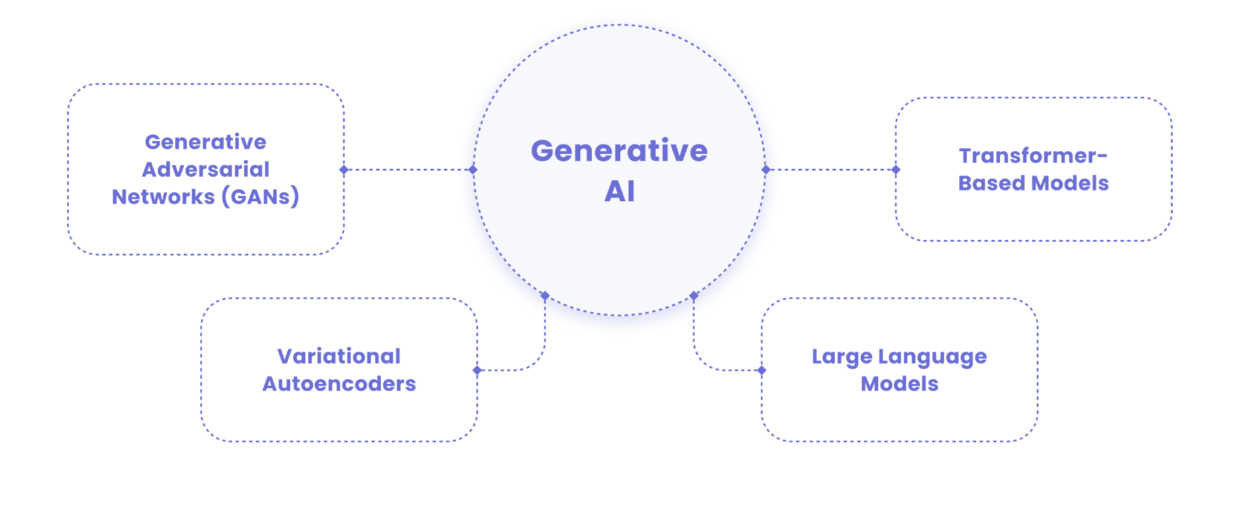
Algorithms under Generative AI
Notes:
Generative AI takes artificial intelligence to a whole new level. Unlike its traditional counterpart, generative AI isn't just about automation; it's about unleashing creativity. The key algorithms under Generative AI are: GAN, Transformer-based models, LLMs, Variational Autoencoders. As generative AI continues to evolve, the possibilities for creative expression are truly boundless.

Slide 22
Traditional AI's Domain
Analyzing large datasets for patterns and trends
Making predictions based on historical data
Automating repetitive tasks with high accuracy
Identifying anomalies and outliers in data sets
Classifying data points into predefined categories
Notes:
Traditional AI can analyze vast amounts of data, identify patterns and trends, and make predictions based on historical information. This allows for optimized production processes, streamlined logistics, and even predictive maintenance. Additionally, traditional AI excels at classifying data points into predefined categories, like spam filtering or identifying fraudulent transactions. These models are the backbone of many automation processes that keep our world running smoothly.

Slide 23
Generative AI's Domain
Generating entirely new and original content (text, images, music)
Personalizing content based on user preferences or demographics
Creating realistic simulations for training or design purposes
Exploring new design concepts and possibilities
Composing music or writing different creative text formats
Notes:
Generative AI can generate entirely original content, be it composing a catchy jingle, writing a poem in the style of your favorite author, or even creating a photorealistic portrait of a person who doesn't exist. This opens doors for personalized marketing campaigns, unique product designs, and even the exploration of entirely new artistic avenues. Generative AI is a powerful tool for pushing the boundaries of creative expression.

Slide 24
Areas where Traditional AI wins
Autonomous Vehicles
Medical Diagnosis
Financial Trading
Risk Management
Notes:
While generative AI brings a spark of creativity, there are still areas where traditional AI reigns supreme. Take self-driving cars, for instance. The ability to react to real-time situations, make split-second decisions based on complex data, and recognize patterns in the environment is what makes traditional AI crucial for this technology. Similarly, in the medical field, traditional AI can analyze medical images like X-rays and MRIs to identify potential abnormalities, assisting doctors in their diagnoses. These are just a few examples of where the accuracy, efficiency, and real-time decision-making capabilities of traditional AI make it an invaluable tool in various industries.

Slide 25
Areas where Generative AI is beneficial
Drug Discovery
Material Science
Personalized Education
Urban Planning
Notes:
Generative AI's potential extends far beyond creating catchy marketing slogans or writing creative fiction. Imagine a world where AI can simulate the properties of new molecules, accelerating the development of life-saving drugs. Or, consider the possibility of designing entirely new materials with specific properties for groundbreaking advancements in various fields. Generative AI also holds immense promise in the area of personalized education, tailoring learning experiences to individual student needs and learning styles. As generative AI continues to evolve, its applications in diverse fields like urban planning and resource management can lead to the creation of more efficient and sustainable cities. The future holds endless possibilities as we unlock the full potential of this powerful technology.

Slide 26
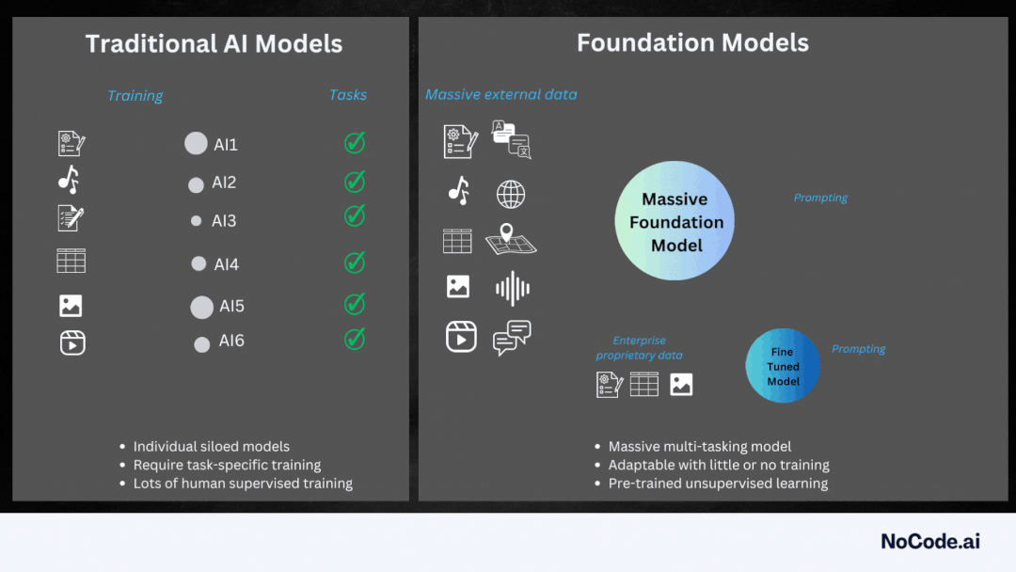
Traditional AI vs Generative AI working
Traditional AI
Generative AI
Notes:
Traditional AI excels at analyzing data and identifying patterns. Imagine a filing cabinet full of labeled documents. Traditional AI meticulously sorts through them, learns the patterns in how they are categorized, and then uses that knowledge to classify new documents.
Generative AI, on the other hand, is the artist in this scenario. It takes the existing documents, understands the underlying styles and structures, and creates entirely new documents that adhere to those patterns. It's like using the knowledge of the filing cabinet to forge new documents that appear genuine.

Slide 27
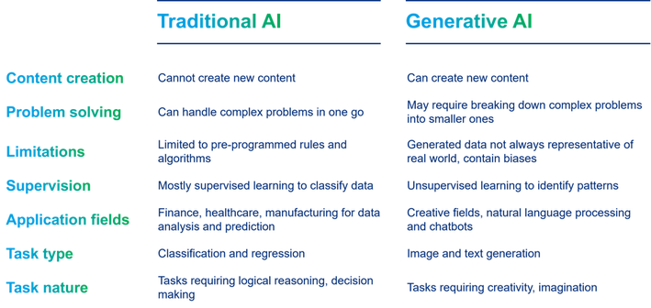
Traditional AI vs Generative AI
Notes:
Traditional AI is rule-based and excels at solving well-defined problems with clear instructions. It can’t create new content, and its solutions are limited to the data it’s trained on. Generative AI, on the other hand, is data-driven and can produce entirely new content, like images or text. It’s often unsupervised, meaning it finds patterns in data without needing human-labeled examples. While powerful, generative AI’s outputs may not always reflect reality.

Slide 28
What are Large Language Models and how it works

Slide 29
Large Language Models
Trained on massive datasets of text
Use deep learning algorithms to learn patterns and relationships
Can generate coherent and context-specific text
Can be fine-tuned for specific tasks, such as language translation or text summarization
Can be integrated into various applications, such as chatbots or writing assistants
Continuously learn and improve with more data and interactions
Notes:
LLMs are able to generate human-like text, which makes them useful for a variety of tasks such as drafting emails, writing code, and answering customer inquiries.
One of the key benefits of LLMs is their ability to understand and respond to a wide range of prompts. This makes them a powerful tool for automating tasks that involve language.
Another advantage of LLMs is that they are constantly learning and improving as they are exposed to more data and feedback.

Slide 30
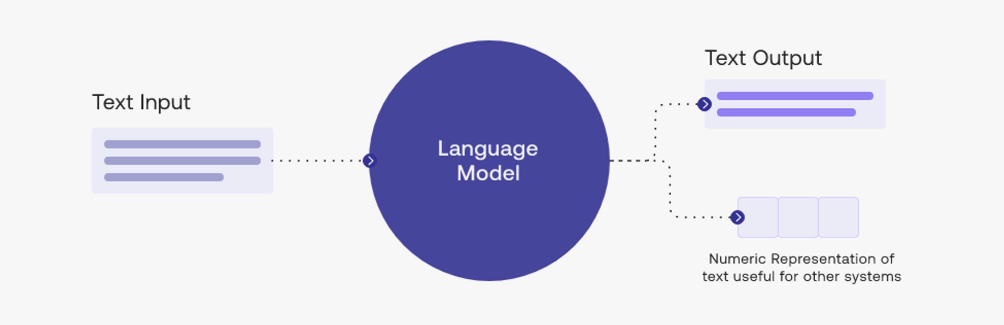
Large Language Models
Notes:
Text input enters the system, and the language model then processes it based on the data it has been trained on.
The output, based on the input, is text output.

Slide 31
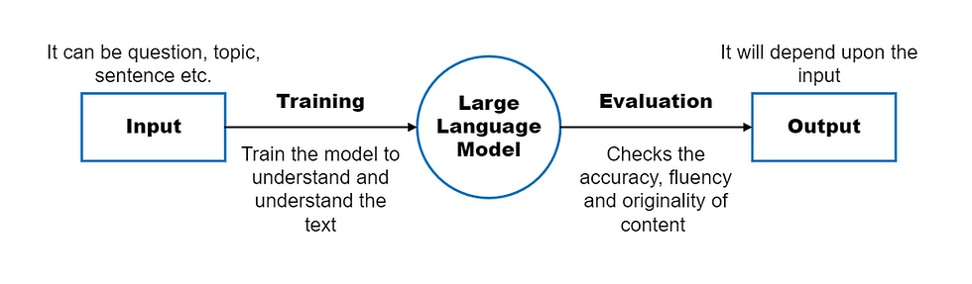
Large Language Models
Notes:
Input: The input is the text that you give to the LLM to ask it to generate new text. The input can be a question, a topic, a sentence, or anything else. The input tells the LLM what kind of text you want it to generate.
Training: The training is the process of teaching the model how to generate and understand the text. The training involves giving the model a lot of text to read and learn from. The training helps the model improve its skills and knowledge of the language.
Model: The model is the LLM itself. It is a computer program that can generate and understand text. The model has learned how to do this by reading a lot of text from different sources, such as books, websites, articles, etc. The model knows how to use words and phrases to make sentences and paragraphs that make sense
Evaluation: The evaluation is the process of checking how good the model is at generating and understanding text. The evaluation involves giving the model some text to generate or analyze and comparing it with the correct or expected text. The evaluation helps measure how accurate, fluent,
coherent, relevant, original, and diverse the model’s text is.
Output: The output is the text that the LLM generates based on the input. The output can be an answer, a story, a summary, or anything else. The output is the new text that the LLM creates for you.

Slide 32

History of Language Models
Early language models: rule-based systems
2010s: statistical language models
2010s: deep learning-based language models
2020s: Large Language Models (LLMs)
Notes:
We've come a long way from the early rule-based systems to the deep learning-based models of today.

Slide 33
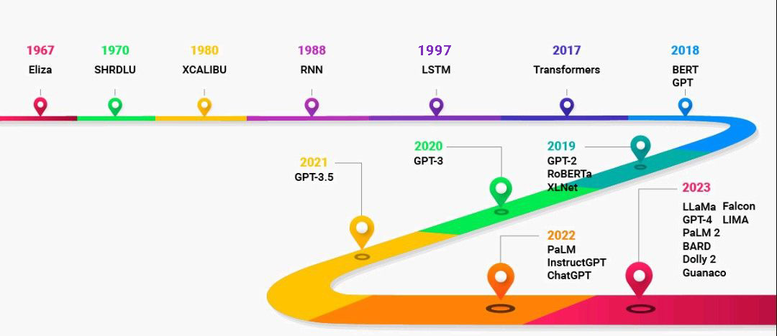
History of Language Models
Notes:
The timeline showcases the evolution of large language models (LLMs) from 1960 to 2023. Early LLMs, like ELIZA in 1967, were rule-based and could only handle simple interactions.
The 1980s and 1990s saw advancements in statistical language processing techniques, with models like RNNs and LSTMs. These models could learn from data and perform tasks like text completion.
The early 2010s marked a shift towards transformers, a deep learning model architecture. This led to the development of powerful LLMs like GPT-2 and BERT in the late 2010s.
The most recent LLMs, like PaLM and LLama, BARD from 2022 and 2023 respectively, can access and process information from the real world through Google Search and keep their responses consistent with search results.

Slide 34
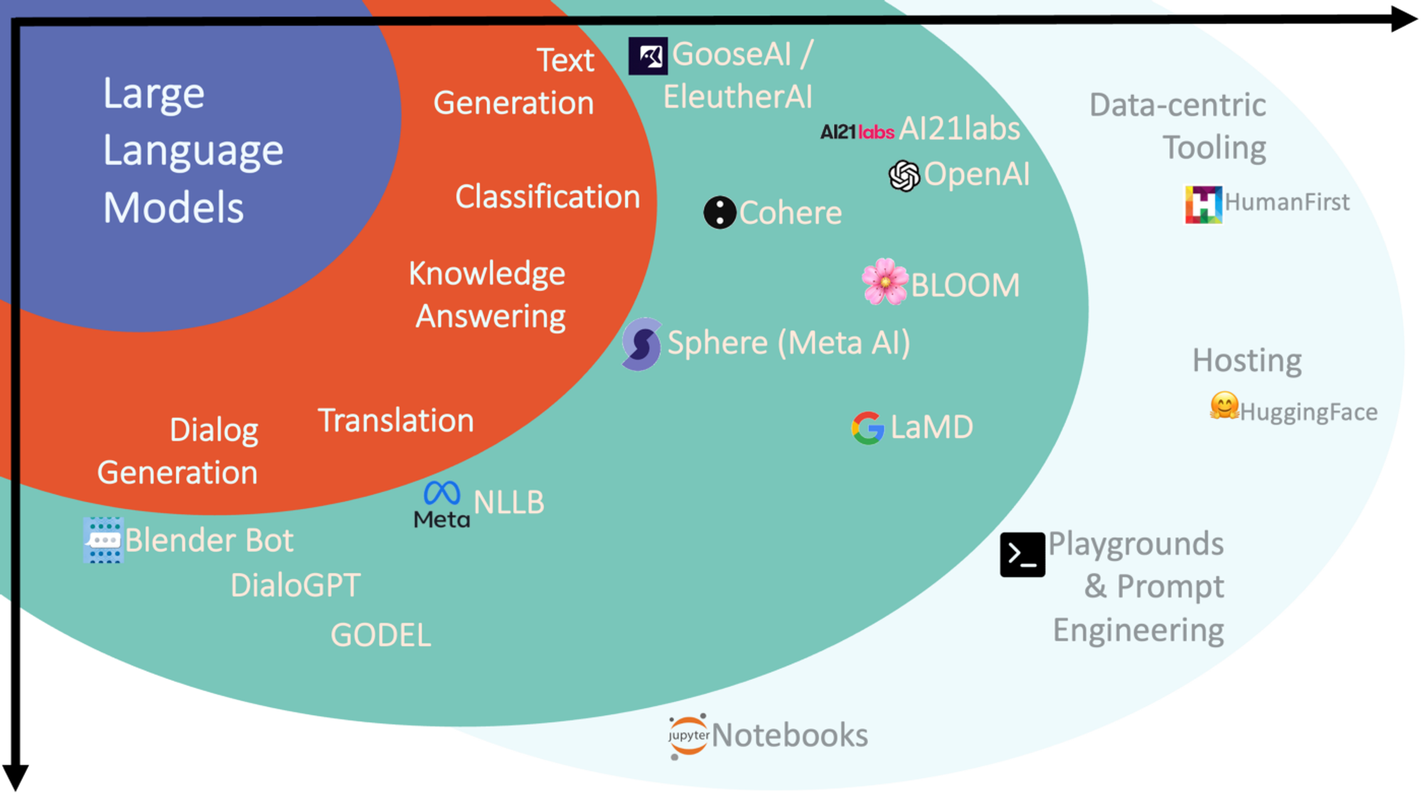
LLM paradigm
Notes:
LLM paradigm

Slide 35
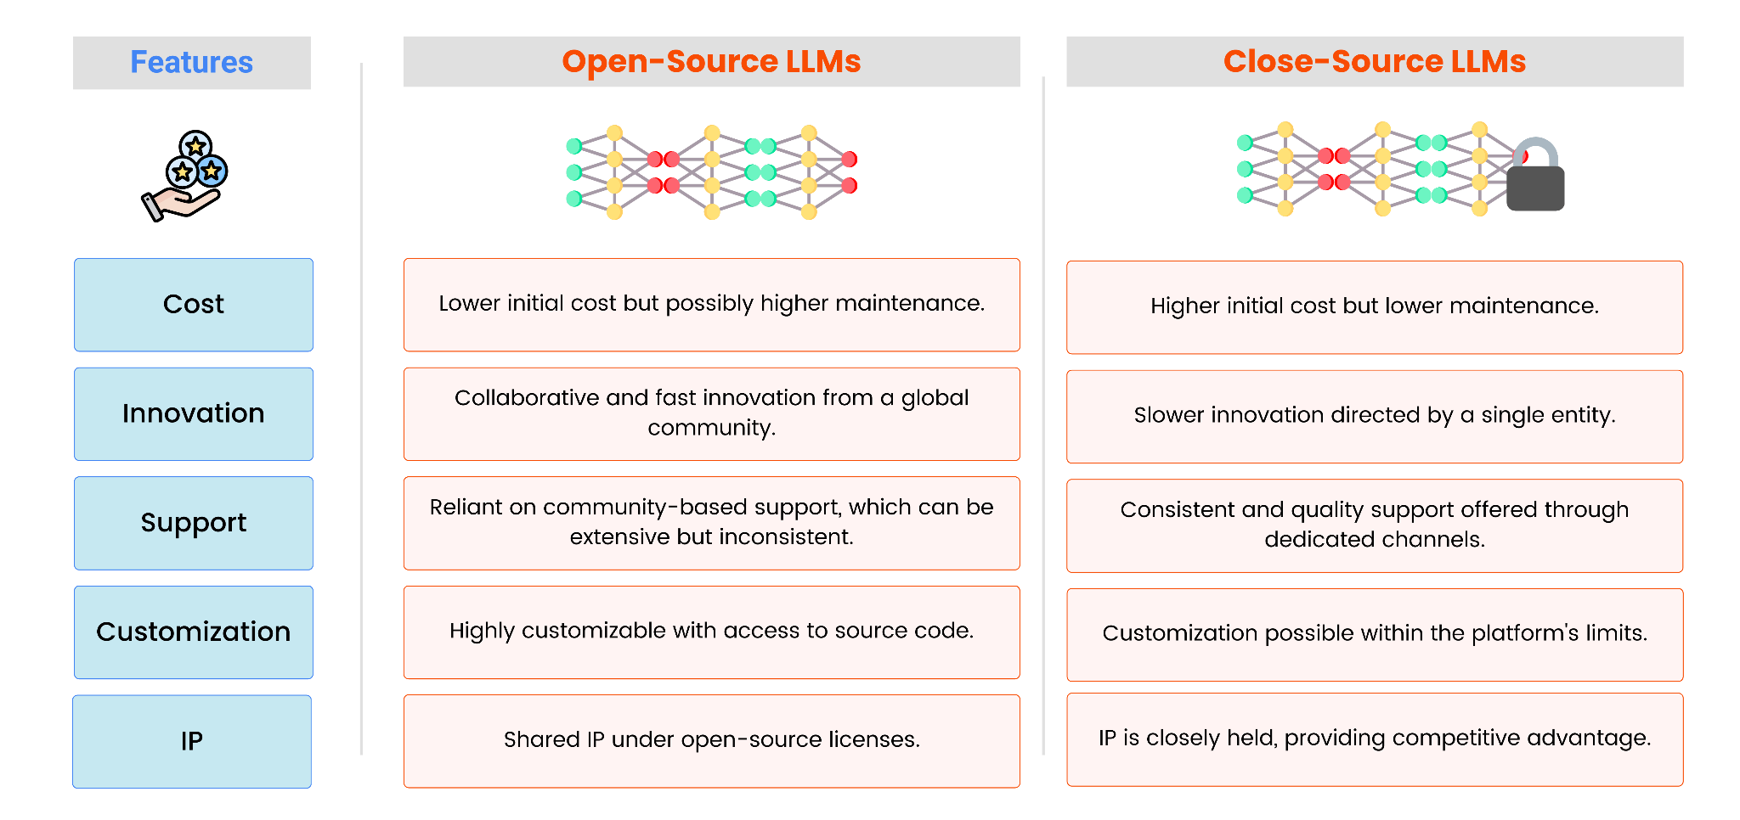
Open Source vs Closed Source LLM
Notes:
The table compares Open Source and Closed Source LLMs in terms of Cost, Innovation, Support, Customization, IP

Slide 36
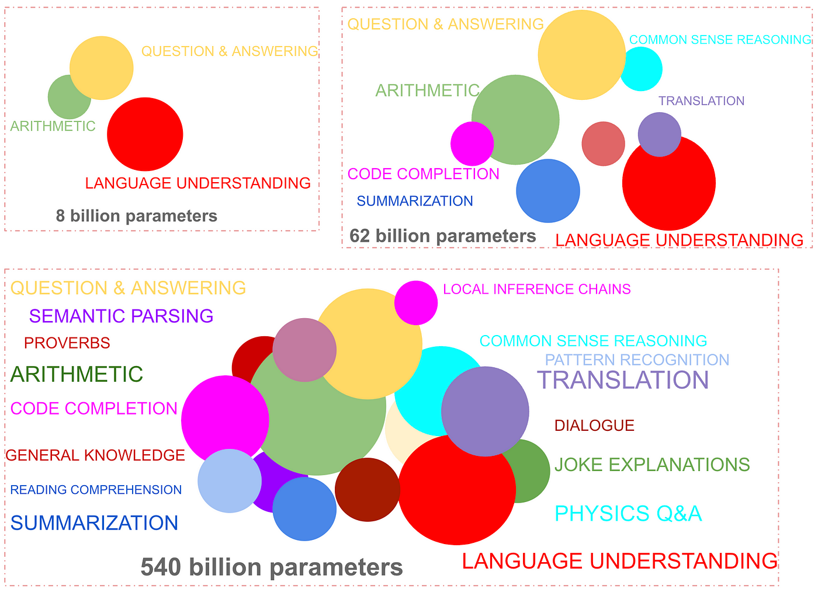
Emerging and Growing capabilities of language models with increased model size
Notes:
The utility of large language models goes beyond their ability to generate coherent stories — they could be leveraged to solve almost any NLP task — both generative and discriminative. Examples of this are noun phrase tagging, NER, relation extraction, classification, coreference resolution, semantic search (sentence embeddings), etc. Also for some of these tasks, the performance may be adequate for production use cases with fine-tuning.

Slide 37
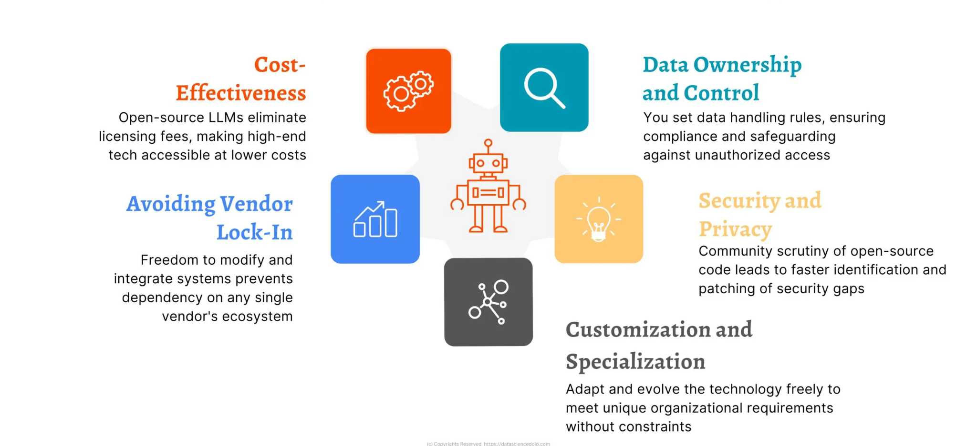
Open Source LLMs
Notes:
open-source LLMs offer several advantages for enterprises. They are cost-effective because there are no licensing fees to pay.
Businesses maintain control over their data and can set data handling rules to ensure compliance and security.
Open-source LLMs avoid vendor lock-in, giving businesses the freedom to modify and integrate the systems with their existing infrastructure.
The open-source nature allows for customization to meet specific needs and fosters a community that can help identify and fix security vulnerabilities.

Slide 38
Open Source LLMs Benefits
Innovation and Community
Open source models encourage collaboration and knowledge sharing
Community-driven development leads to faster innovation and improvement
Access to a large community of developers and researchers
Open source models can be used for a wide range of applications
Encourages diversity and inclusivity in AI development
Faster adaptation to changing business needs
Notes:
By using open source models, we're tapping into a large community of developers and researchers who are working together to improve the model. This leads to faster innovation and improvement, which is critical in the fast-paced commerce industry. Additionally, open source models encourage diversity and inclusivity in AI development, which is essential for building fair and unbiased models. By leveraging the power of the open source community, we can stay ahead of the curve and adapt quickly to changing business needs

Slide 39
Open Source LLMs Benefits
Transparency and Customizability
Provide transparency into the model's architecture and training data
Customizability allows for fine-tuning to specific business needs
Community-driven development leads to faster bug fixes and improvements
Open source models can be easily integrated with existing infrastructure
No vendor lock-in and reduces dependence on a single provider
Encourages collaboration and knowledge sharing within the organization
Notes:
One of the biggest advantages is transparency. With open source, we can see exactly how the model is built and trained, which is crucial for businesses that require explainability and accountability. Additionally, we can customize the model to fit our specific needs, which is not possible with closed source models. This leads to faster development and deployment, and we're not tied to a single vendor. This is especially important in the commerce industry, where adaptability is key.

Slide 40
Open Source LLMs Benefits
Cost-Effectiveness and Security
Open source models reduce costs associated with licensing and maintenance
No need to pay for proprietary software or vendor support
Community-driven development reduces the risk of security vulnerabilities
Can be easily audited for security and compliance
Lower costs enable businesses to allocate resources to other areas
Open source models can be used for a wide range of applications
Notes:
By using open source models, we can significantly reduce our costs associated with licensing and maintenance. We're not paying for proprietary software or vendor support, which frees up resources for other areas of the business. Additionally, open source models are more secure, as the community-driven development process reduces the risk of security vulnerabilities. This is critical in the commerce industry, where security breaches can have devastating consequences.

Slide 41
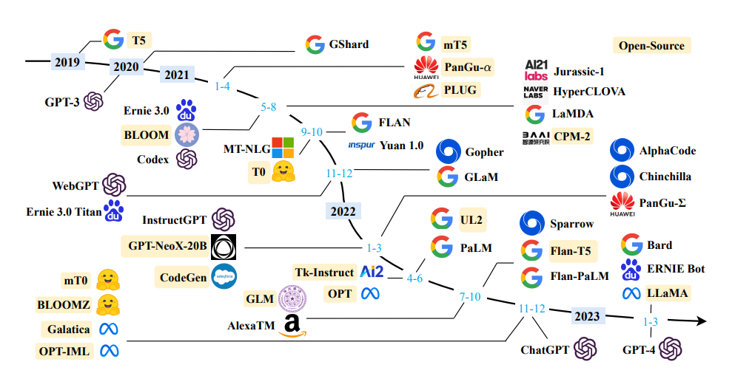
Open Source LLMs
Notes:
Here's a breakdown of some notable open-source LLMs and their approximate release years:
Before 2022:
GPT-2 (OpenAI): Released in 2019, GPT-2 is a foundational model that paved the way for many later open-source LLMs. However, due to concerns about potential misuse, OpenAI limited access to the full model.
2022:
Jurassic-1 Jumbo (AI21 Labs): Released in early 2022, Jurassic-1 Jumbo was one of the first large open-source LLMs boasting high parameter counts.
Late 2022 - Early 2023:
BLOOM (BigScience): A collaborative project involving multiple institutions, BLOOM was released in late 2022 and is known for its focus on multilingual capabilities.
GPT-J (EleutherAI): A continuation of the GPT-2 line, GPT-J, released in late 2022, aimed to provide a more accessible and powerful open-source alternative.
2023:
LLaMA (Meta AI): Released in February 2023 with initial access restrictions, LLaMA quickly gained attention for its performance on benchmarks. Later revisions relaxed access and allowed commercial use.
Mistral 7B (Mistral): Released in September 2023, Mistral 7B offered competitive performance compared to other open-source models at its size.

Slide 42

Popular Open Source LLMs in Market
Llama3
Release Date: 18 April 2024
Developed by Meta AI
Trained on 15 trillion data tokens from publicly available sources
Capable of understanding and responding to human input in a conversational manner
Can be fine-tuned for specific tasks and industries
Notes:
LLaMA3 stands for Large Language Model Meta AI, version 3. It's an open-source, accessible AI system developed by Meta. Imagine having an incredibly knowledgeable and versatile assistant at your fingertips. That's essentially what LLaMA3 is. It's been trained on a massive dataset of text and code, giving it the ability to understand and respond to a wide range of prompts and questions. Beyond basic communication, LLaMA3 can generate different creative text formats, translate languages, write different kinds of creative content, and answer your questions in an informative way. We'll explore these capabilities further in the next slide.

Slide 43

Popular Open Source LLMs in Market
Mistral
Release Date: September 27, 2023
Versions:
Open-weight models:
Mistral 7B
Mixtral 8x7B
Mixtral 8x22B
Notes:
Mistral was first released on 27 september 2023. Version of Open-weight models:
Mistral 7B: A smaller, efficient model well-suited for basic tasks in English.
Mixtral 8x7B (pronounced Mistral 8 times 7B): Offers multilingual capabilities (English, French, Italian, German, Spanish) and a larger capacity for more complex tasks.
Mixtral 8x22B: The most advanced open-weight model, boasting a significant parameter size for tackling demanding tasks across multiple languages.

Slide 44
Popular Open Source LLMs in Market
Mistral
Release Date: September 27, 2023
Versions:
Optimized commercial models:
Mistral Small
Mistral Medium
Mistral Large
Mistral Embeddings
Notes:
Mistral Small: A well-balanced option offering good performance for various commerce tasks.
Mistral Medium: This version is being deprecated, with its functionality likely incorporated into future iterations of Mistral Small or Large.
Mistral Large: The current flagship model, delivering the highest performance among Mistral's commercial offerings.
Mistral Embeddings: A specialized model designed for tasks like text similarity and information retrieval.

Slide 45

Popular Open Source LLMs in Market
Falcon
Release Date: 06 September, 2023
Developed by Technology Innovation Institute (TII)
Capable of understanding and generating human-like language
Can be fine-tuned for specific industries and use cases
Supports multiple languages and dialects
Notes:
Falcon LLM entered the scene on September 6th, 2023, brought to life by the Technology Innovation Institute (TII). This innovative technology stands out for its ability to understand and generate human-like language, making it a powerful tool for various applications. A key strength of Falcon LLM is its versatility. It can be fine-tuned to cater to the specific needs of different industries and use cases. Additionally, Falcon LLM boasts multilingual capabilities, supporting multiple languages and dialects, making it a valuable asset for reaching global audiences.

Slide 46
Popular Open Source LLMs in Market
Falcon
Falcon 180B
The largest and most powerful Falcon LLM
Ideal for complex tasks requiring massive datasets.
Falcon 40B:
Has 40 billion parameters
Offers a strong balance between power and efficiency.
Notes:
Falcon 180B: This heavyweight champion is the most powerful Falcon LLM, crunching through massive datasets for complex tasks. It’s ideal for large organizations with significant computational resources, but may require specific licensing due to its immense capabilities.
Falcon 40B: It’s the flagship model, offering a powerful balance between processing might and efficiency. This makes it a versatile choice for a wide range of e-commerce applications, from personalizing marketing campaigns to automating repetitive tasks.

Slide 47
Popular Open Source LLMs in Market
Falcon
Falcon 7.5B:
A more efficient option with 7.5 billion parameters
Ideal for tasks that require good performance
Falcon 1.3B
The most lightweight version with 1.3 billion parameters
suitable for tasks where resource limitations exist or for initial exploration of Falcon LLM capabilities
Notes:
Falcon 7.5B: The Falcon 7.5B packs a punch while being lighter on resources. It’s ideal for tasks that require good performance without the heavyweight power of the 40B version. This could be a good option for smaller businesses or for exploring Falcon LLM’s capabilities before diving into the larger models.
Falcon 1.3B: The most lightweight Falcon LLM, the 1.3B version is perfect for situations with resource limitations or for initial testing. It’s a handy tool to experiment with Falcon LLM’s abilities and get acquainted with its potential before deploying it in larger-scale projects.

Slide 48
Closed Source LLMs Benefits
Control and Customization
Proprietary data protection
Customizable architecture
Enhanced security
Faster deployment
Better support
Notes:
With a closed source model, you have complete control over your data and can customize the architecture to fit your specific business needs. This means you can ensure proprietary data protection, reducing the risk of data breaches and cyber attacks. You'll also receive dedicated support from the model's creators, and can deploy the model quickly and efficiently. Plus, you'll have better protection for your intellectual property and trade secrets.

Slide 49
Closed Source LLMs Benefits
Performance and Scalability
Optimized performance
Scalability
Faster processing
Better resource allocation
Enhanced reliability
Improved maintainability
Notes:
Closed source Large Language Models are optimized for performance, allowing you to handle large volumes of data and traffic with ease. This means you can process information faster, reduce processing time, and increase productivity. You'll also be able to make the most of your computational resources, ensuring better resource allocation. Plus, you'll experience enhanced reliability, minimizing downtime and ensuring consistent performance. And, with closed source models, maintenance is a breeze, making it easy to update and maintain the model.

Slide 50
Closed Source LLMs Benefits
Cost-Effectiveness and ROI
Reduced development costs
Lower maintenance costs
Faster ROI
Increased revenue
Better resource allocation
Competitive advantage
Notes:
With closed source Large Language Models, you can reduce development costs by leveraging existing models and expertise. You'll also minimize maintenance costs, as you won't need to invest in in-house development. This means you can realize the benefits of LLMs quickly and efficiently, driving business growth and increasing revenue. You'll be able to focus on high-value tasks and strategic initiatives, and stay ahead of the competition with cutting-edge technology. In conclusion, closed source Large Language Models offer a range of benefits that can drive business success

Slide 51





Popular Closed Source LLMs in Market
Notes:
The slide depicts various Popular Closed Source LLMs in Market.

Slide 52
Popular Open Source LLMs in Market
ChatGPT
Release Date: November 30, 2022
Trained on a massive dataset of 45GB of text, making it one of the largest language models ever created
Can be fine-tuned for specific tasks, such as text classification, language translation, and text generation
Has the potential to revolutionize industries such as customer service, marketing, and content creation
Notes:
As managers, you're likely familiar with the importance of effective communication in driving business success. GPT-3.5 is a game-changer in this space, allowing us to automate and enhance many language-based tasks.

Slide 53
Popular Open Source LLMs in Market
ChatGPT
GPT 3
GPT 3.5
GPT 4
Notes:
GPT, or Generative Pre-trained Transformer, has evolved through several versions. While details of earlier versions are limited, GPT-3 gained recognition for its ability to generate human-quality text. The latest iteration, GPT-4, boasts significant advancements. It features larger model sizes, improved context windows, and enhanced capabilities in areas like code generation and handling complex instructions. With each iteration, GPT pushes the boundaries of what AI can achieve in language processing.

Slide 54
Popular Open Source LLMs in Market
Gemini
Release Date: 6 December 2023
Decoder-only Transformers
Multimodal Capabilities
Three main generations of Gemini:
Gemini Ultra
Gemini Pro (including 1.0 and 1.5)
Gemini Nano
Notes:
Unlike traditional models with encoder and decoder structures, Gemini focuses solely on decoding input into desired outputs, making it efficient for tasks like question answering and summarization. Gemini is multimodal. This means it can not only process text but also understand and integrate information from images, audio, and other formats. This allows for a more nuanced understanding of customer data and trends. There are three main generations of Gemini:
Gemini Ultra: The largest and most powerful model, ideal for highly complex tasks requiring extensive data processing.
Gemini Pro (including 1.0 and 1.5): The most versatile model, suitable for a wide range of commerce-related tasks and offering a balance between capability and efficiency.
Gemini Nano: The most lightweight model, designed for on-device applications where processing power might be limited.

Slide 55
Popular Open Source LLMs in Market
Claude
Release Date: March 2023
Isn't a single model
A family of large language models developed by Anthropic.
Versions:
Claude
Claude 2, 2.1
Claude 3 (Haiku, Sonnet, Opus)
Notes:
Anthropic launched the initial Claude model in March 2023. This was followed by a series of advancements, with Claude 2 and its update, 2.1, offering improved capabilities. The latest iteration, Claude 3, takes things a step further. Imagine Claude 3 with different versions like Haiku, Sonnet, and Opus – each potentially tailored for specific strengths or functionalities. This family approach ensures Claude can adapt to your evolving needs.

Slide 56
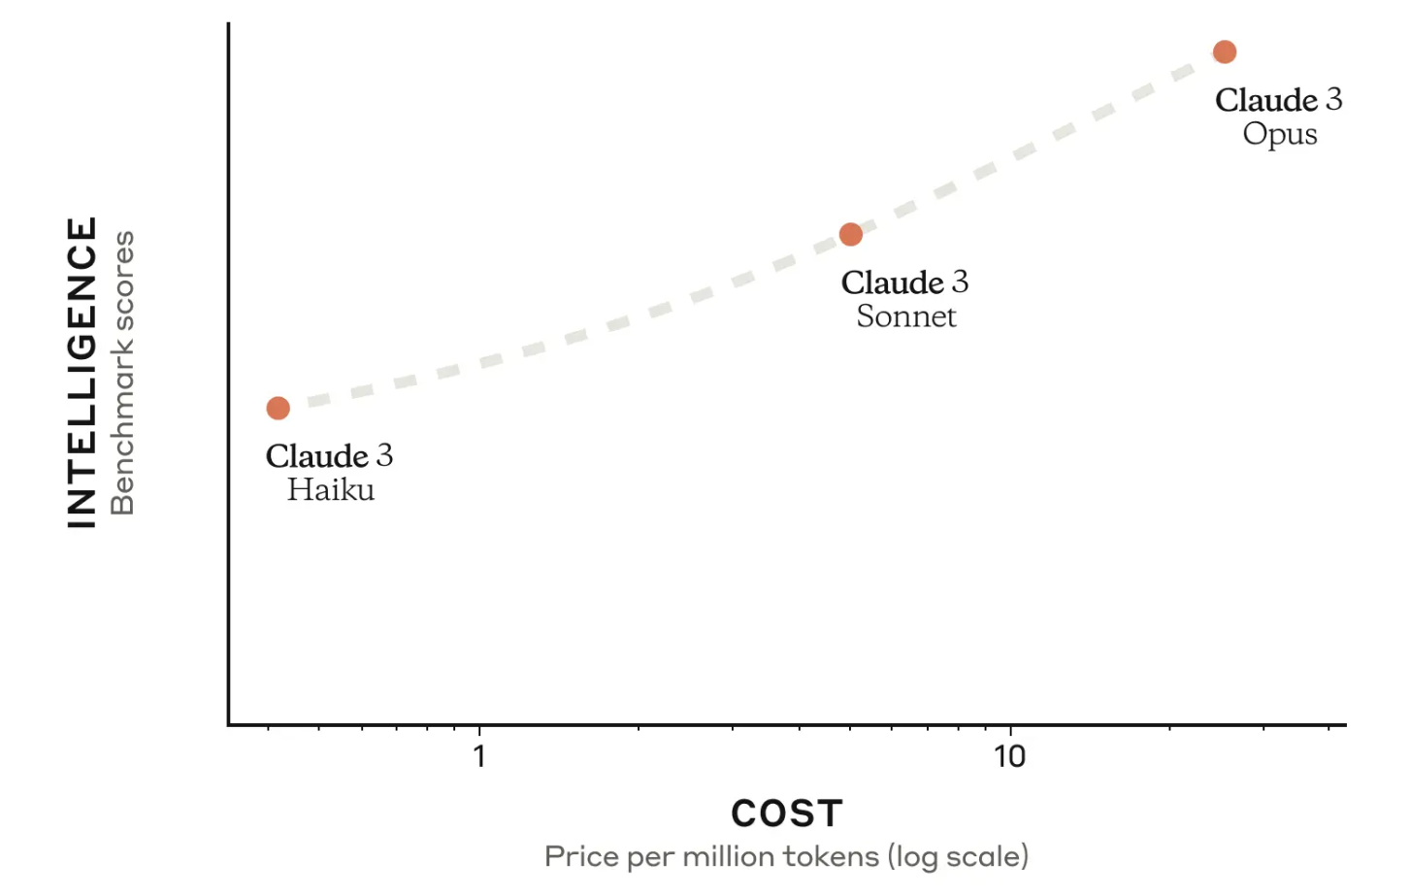
Popular Open Source LLMs in Market
Claude
Notes:
Anthropic launched the initial Claude model in March 2023. This was followed by a series of advancements, with Claude 2 and its update, 2.1, offering improved capabilities. The latest iteration, Claude 3, takes things a step further. Imagine Claude 3 with different versions like Haiku, Sonnet, and Opus – each potentially tailored for specific strengths or functionalities. This family approach ensures Claude can adapt to your evolving needs.

Slide 57
Popular Open Source LLMs in Market
Claude
Capabilities
Reasoning:
Can handle complex cognitive tasks that go beyond simple pattern recognition
Vision Analysis
Can analyze and transcribe information from images
Notes:
Claude's capabilities extend beyond standard language processing. It possesses impressive reasoning abilities, allowing it to tackle complex cognitive tasks that go far beyond just recognizing patterns in data. This opens doors for tasks like solving puzzles, analyzing arguments, and drawing logical conclusions. Additionally, Claude isn't limited to text – it can also analyze and transcribe information from visual sources like images. Imagine extracting data from charts, deciphering handwritten notes, or even understanding the content of photographs – Claude's vision analysis capabilities unlock a whole new dimension of data processing.

Slide 58
Popular Open Source LLMs in Market
Claude
Capabilities
Code Generation
Claude can assist with tasks like website creation, data conversion, and debugging codebases
Multilingual Processing
Claude can translate languages, analyze grammar, and even create multilingual content
Notes:
Beyond streamlining communication and content creation, Claude offers a powerful toolkit for developers. It can assist in building websites by generating HTML and CSS code. Claude can also convert data from one format to another, saving valuable time and effort. And for programmers wrestling with complex codebases, Claude can provide debugging assistance, helping identify and resolve issues more efficiently. Additionally, Claude's multilingual capabilities extend beyond translation. It can analyze grammar across different languages and even create multilingual content, a valuable asset for businesses operating in a globalized market.

Slide 59
Working of LLMs
The Learning Process
Massive datasets are fed into the LLM
The model analyzes word sequences and relationships
Identifies statistical patterns in how language works
Learns to predict the next word in a sequence
Notes:
The magic behind large language models lies in their learning process. By ingesting massive datasets of text and code, these models become sophisticated language learners. They analyze the order and relationships between words, uncovering the statistical patterns that govern human language. Through this analysis, they develop the ability to predict the next word in a sequence, allowing them to generate human-like text, translate languages, and even write different kinds of creative content.

Slide 60
Working of LLMs
Building Blocks of LLMs
Encoder: processes input text into numerical representations
Decoder: generates output text based on encoder output
Attention mechanism: focuses on relevant parts of input text
Embeddings: convert words into numerical vectors
Training objectives: optimize model performance
Notes:
You'll notice the encoder, decoder, attention mechanism, embeddings, and training objectives. These components work together to enable LLMs to understand and generate human-like language

Slide 61
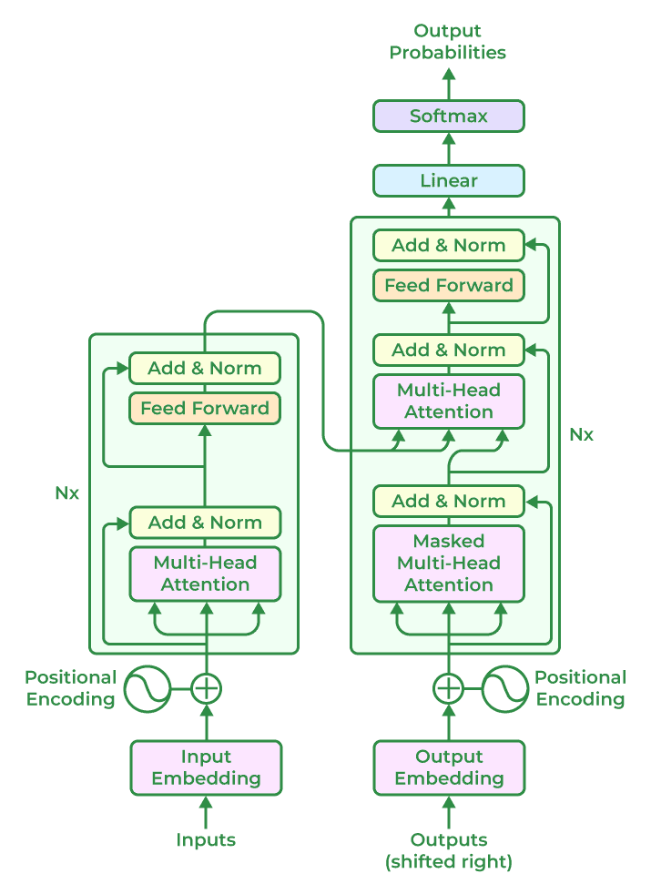
Working of LLMs
Architecture behind LLMs
Notes:
The main architecture behind LLMs is Transformer. Transformer models are a powerful type of neural network architecture that excel at understanding long-range dependencies in language. Unlike traditional RNNs that process information sequentially, transformers analyze all parts of the sentence simultaneously. They achieve this through two key components: encoder and decoder. The encoder captures the relationships between words in the input text, while the decoder uses this information to generate the output, predicting the most likely word next in the sequence. This parallel processing allows transformers to handle complex relationships in language, making them a critical component in many advanced LLMs.

Slide 62
Working of LLMs
The Training Game
LLMs are trained on massive datasets, often for weeks or months
The model receives input text and tries to predict the next word
The system compares its prediction to the actual next word in the data
Based on the accuracy, the network adjusts its connections and learns from its mistakes
Notes:
Training an LLM is like teaching a child. We feed it a massive dataset, like a giant textbook. The LLM then takes a stab at predicting the next word in a sequence. If it gets it right, hooray! If not, the system adjusts the connections within its neural network, learning from its mistakes. This iterative process, repeated millions of times, allows the LLM to become a master of language prediction.

Slide 63
Working of LLMs
The Power of Context
Understanding Context is Key
LLMs consider the surrounding text to understand the meaning of a word
The same word can have different meanings based on context
"The bank is closed today" vs. "He deposited money at the bank."
Notes:
Just like humans rely on context to understand a conversation, LLMs do too. The surrounding words provide clues about the meaning of a particular word. For example, the word "bank" can refer to a financial institution or the edge of a river. By analyzing the context, the LLM can determine the intended meaning. This ability to understand context is crucial for generating relevant and accurate responses.

Slide 64
Basics of Prompt Engineering for GenAI

Slide 65
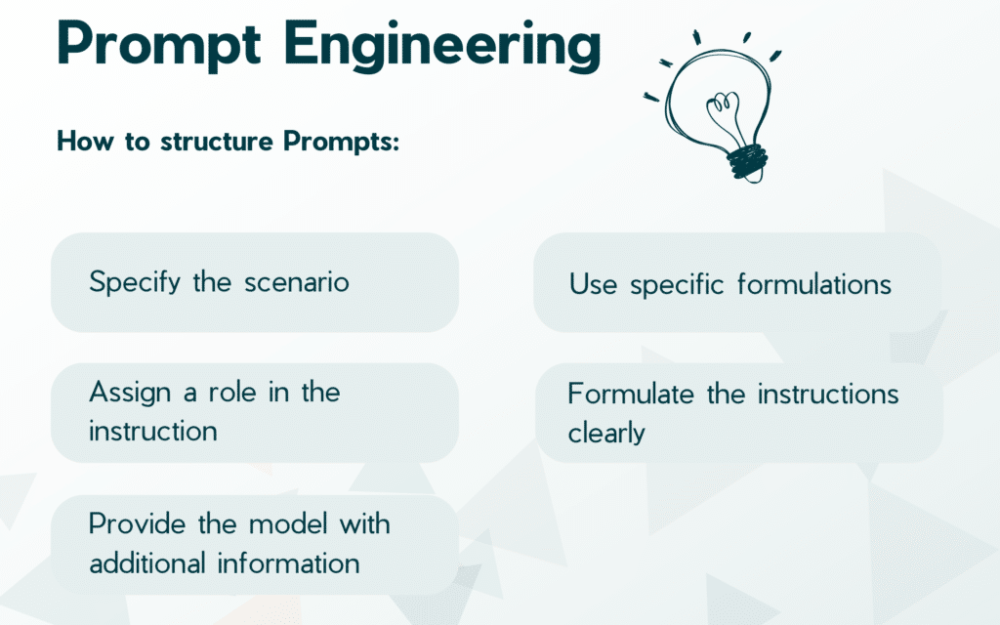
Notes:
Prompt Engineering is the art of crafting clear and concise instructions for the AI model. Think of it like giving a creative team a detailed brief. The more specific your prompt is, the better the model will understand your vision and generate content that aligns with your goals.

Slide 66
Importance of Prompt Engineering
Influencing GenAI model behavior
Shaping output quality and relevance
Mitigating biases and errors
Enhancing user experience
Unlocking business value
Notes:
Prompt Engineering is critical because it directly influences the behavior of GenAI models, output quality, and user experience. By getting it right, we can unlock significant business value and mitigate potential risks.

Slide 67
Key Elements of a Prompt
Instruction: Clearly states the task (e.g., translate, write, list ideas).
Context: Provides background information (e.g., style, tone, genre).
Input Data: The specific content the model works with (e.g., text, code).
Output Indicator: Defines the desired format (e.g., list, paragraph, code).
Notes:
Instruction: This is the directive given to the model that details what is expected in terms of the task to be performed. This could range from “translate the following text into French” to “generate a list of ideas for a science fiction story”. The instruction is usually the first part of the prompt and sets the overall task for the model.
Context: This element provides additional information that can guide the model’s response. For instance, in a translation task, you might provide some background on the text to be translated (like it’s a dialogue from a film or a passage from a scientific paper). The context can help the model understand the style, tone, and specifics of the information needed.
Input data: This refers to the actual data that the model will be working with. In a translation task, this would be the text to be translated. In a question-answering task, this would be the question being asked.
Output indicator: This part of the prompt signals to the model the format in which the output should be generated. For instance, you might specify that you want the model’s response in the form of a list, a paragraph, a single sentence, or any other specific structure. This can help narrow down the model’s output and guide it towards more useful responses.

Slide 68
Types of Prompts
Open-ended prompts
Closed-ended prompts
Multi-step prompts
Adversarial prompts
Hybrid prompts
Notes:
Prompts come in different flavors, each with its strengths and weaknesses. Understanding the types of prompts helps us design more effective input prompts for our GenAI models.

Slide 69
Types of Prompts
Open-Ended Prompts:
Encourage free-form responses
Allow for creative expression
Often used in creative writing, brainstorming, and idea generation
Closed-Ended Prompts:
Elicit specific, concise responses
Often used in surveys, polls, and multiple-choice questions
Can be used to gather data or opinions
Notes:
Open-ended prompts are like asking open-ended questions. They encourage the AI to explore freely and generate creative content. This is perfect for brainstorming ideas, writing stories, or crafting marketing copy with a unique voice. On the other hand, closed-ended prompts are more like multiple-choice questions. They guide the AI towards a specific answer or output. This is ideal for gathering data, conducting surveys, or generating content with a predefined format, like product descriptions.

Slide 70
Types of Prompts
Multi-Step Prompts:
Comprise a series of related prompts
Guide the user through a process or task
Often used in tutorials, instructions, and workflows
Adversarial Prompts:
Designed to test or challenge the AI model
May contain ambiguities, contradictions, or edge cases
Used to evaluate model robustness and resilience
Notes:
Multi-step prompts act like a recipe, breaking down complex tasks into smaller, easier-to-follow instructions. Imagine a tutorial where each step guides the user through the process, leading to the desired outcome. This is ideal for complex tasks like workflows or detailed explanations.
On the other hand, adversarial prompts are designed to test the AI's limits. Think of them as puzzles or riddles. They might contain contradictions, misleading information, or unusual scenarios to see how the model responds. This helps us evaluate the model's robustness and ability to handle unexpected situations.

Slide 71
Types of Prompts
Hybrid Prompts:
Combine elements of open-ended and closed-ended prompts
Offer flexibility while still guiding the response
Often used in applications requiring both creativity and structure
Contextual Prompts:
Take into account the user's context, preferences, and goals
May use personalization, profiling, or behavioral data
Often used in personalized recommendations, chatbots, and virtual assistants
Notes:
Hybrid prompts act like a recipe – they provide a framework (closed-ended elements) with room for creativity (open-ended elements). This is perfect for tasks that need both structure and a personal touch, like crafting product descriptions with a unique brand voice. Contextual prompts are like having a conversation with your AI. They consider your background, preferences, and goals (like your shopping history) to tailor the response. This makes them ideal for situations where personalization is key, such as chatbots recommending products you might actually like.

Slide 72
Prompt Engineering Process
Research and Data Gathering:
Identify relevant data sources for understanding user needs and context
Analyze existing prompts and AI outputs to gather insights for crafting effective prompts
Designing the Prompt Structure:
Define the purpose and desired outcomes of the AI model.
Structure the prompt with clear instructions, context, and parameters for AI input.
Testing and Refining the Prompt:
Conduct iterative testing using sample data to assess AI's response to the prompt
Refine the prompt based on testing results and incorporate feedback for optimization
Notes:
The prompt engineering process involves thorough research to understand user needs and context, followed by designing a structured prompt that guides AI effectively. Iterative testing and refinement are crucial for optimizing the prompt's performance.

Slide 73
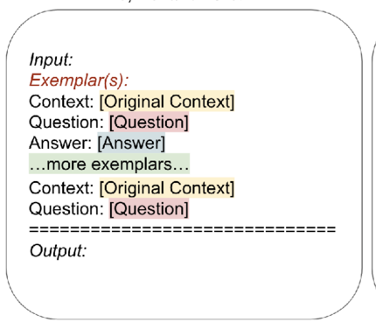
Prompt Templates
Standardized Format
Predefined Parameters
Efficiency in Design
Adaptability
Scalability
Feedback Integration
Notes:
Standardized Format: Templates provide a standardized structure for prompts, ensuring consistency and clarity in communication with AI models.
Predefined Parameters: Templates include predefined parameters such as keywords, context, and desired outputs, guiding AI to generate relevant content.
Efficiency in Design: Using templates streamlines the prompt design process, saving time and effort in crafting effective inputs for AI.
Adaptability: Templates can be adapted for various use cases and scenarios, allowing flexibility while maintaining a structured approach to prompt engineering.
Scalability: Scalable templates enable the creation of multiple prompts with similar structures, facilitating large-scale AI training and deployment initiatives.
Feedback Integration: Templates can incorporate feedback mechanisms, enabling continuous improvement and refinement of prompt designs based on AI performance.

Slide 74
Prompting Types
Types of Prompting
Prompting with Examples (One-, Few-shot)
Direct Prompting (Zero-Shot)
Notes:
There are several prompting techniques you can utilize. Direct prompting is straightforward, ideal for clear-cut tasks like writing product descriptions. Prompting with examples provides the AI with a reference point, useful for capturing a specific style or tone.

Slide 75
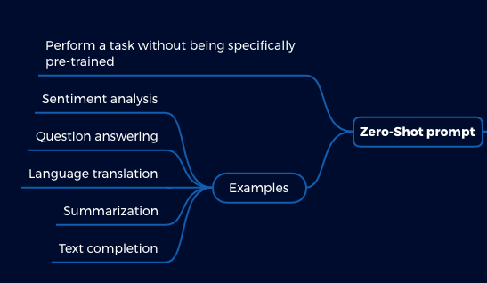
Prompting Types
Zero Shot Prompting
Notes:
Direct prompting is the most straightforward technique. Imagine you have a clear idea in mind, and you simply need GenAI to execute it. Just like giving instructions through a megaphone, you provide concise directions for the desired output. No additional training is required – GenAI can understand and complete the task based on your prompt alone. This is ideal for well-defined tasks where you know exactly what you want, such as writing product descriptions, email subject lines, or short summaries.

Slide 76
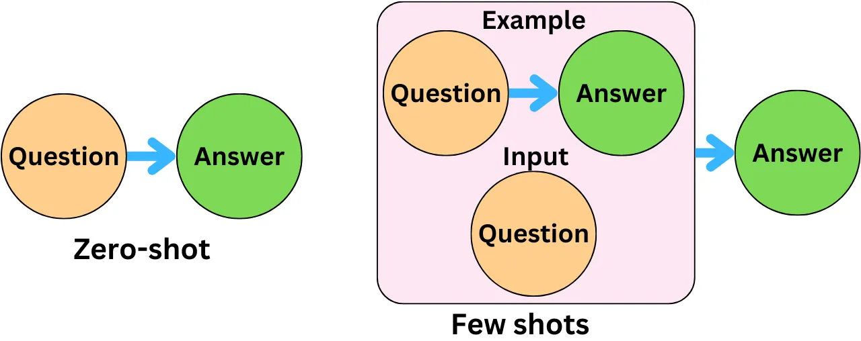
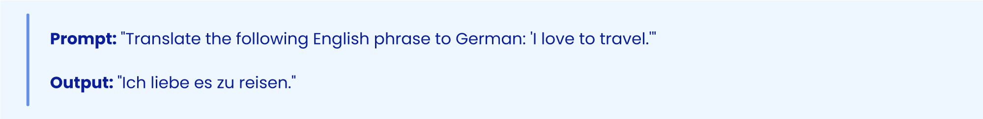
Prompting Types
Zero Shot Prompting
Notes:
Imagine feeding an AI model a prompt in one language and requesting a translation into another language that it hasn't been explicitly trained on. This zero-shot capability showcases the AI's ability to generalize and understand languages beyond its training data, opening doors to multilingual translation with minimal training effort.

Slide 77
Prompting Types
Zero Shot Prompting
Challenges and Limitations:
Limited domain adaptation.
Limited ability to generalize to unseen tasks.
Limited ability to handle out-of-distribution inputs.
Limited ability to handle adversarial attacks.
Limited ability to handle noisy or corrupted data.
Notes:
While zero-shot prompting holds tremendous potential, it's essential to acknowledge its limitations. Zero-shot prompting is not a silver bullet, and it's crucial to understand its challenges and limitations. These limitations include limited domain adaptation, limited ability to generalize to unseen tasks, and limited ability to handle out-of-distribution inputs.

Slide 78
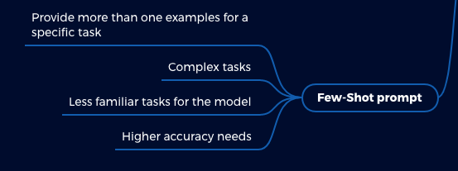
Prompting Types
Few Shot Prompting
Notes:
Prompting with examples becomes even more powerful when you provide multiple references. Imagine showing a collage of social media posts in different styles – humorous, informative, and inspirational. This is called few-shot or multi-shot prompting, depending on the number of examples you provide. The more examples you offer (ideally 2 or more for few-shot and even more for multi-shot), the better GenAI can understand your vision and the nuances you desire.

Slide 79
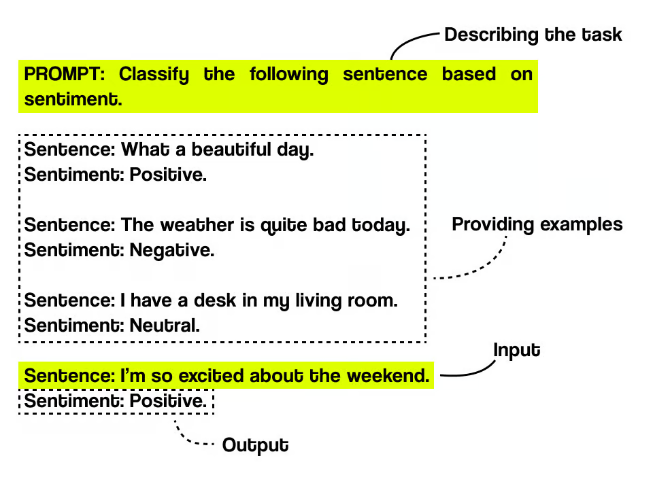
Prompting Types
Few Shot Prompting
Notes:
Few-shot prompting helps you guide GenAI with a few examples. First, define what you want GenAI to create, like a social media post. Then, provide 2-3 high-quality examples that showcase the desired style and tone. Finally, combine your main prompt with these examples (separately or integrated) to give GenAI clear instructions. Review the generated output and refine your examples or prompt if needed to achieve the content you envisioned.

Slide 80
Prompting Types
Few Shot Prompting
Data Availability
Sample Bias
Generalizability
Interpretability
Notes:
Data Availability: Few-shot prompting requires a small amount of data, but it still needs to be carefully curated. Finding high-quality and representative examples can be time-consuming and expensive, especially for complex tasks.
Sample Bias: The performance of the model heavily relies on the quality of the few-shot examples provided. If the examples are biased or not representative enough, the model will learn those biases and limitations and perform poorly on unseen data.
Generalizability: Few-shot prompting is great for specific tasks, but generalizing that learned knowledge to new situations can be difficult. Models trained on a few examples may struggle with unseen tasks or variations on the task they were prompted on.
Interpretability: It can be challenging to understand how the model arrives at its outputs based on the few-shot examples. This makes it difficult to debug any issues or improve the model's performance.

Slide 81
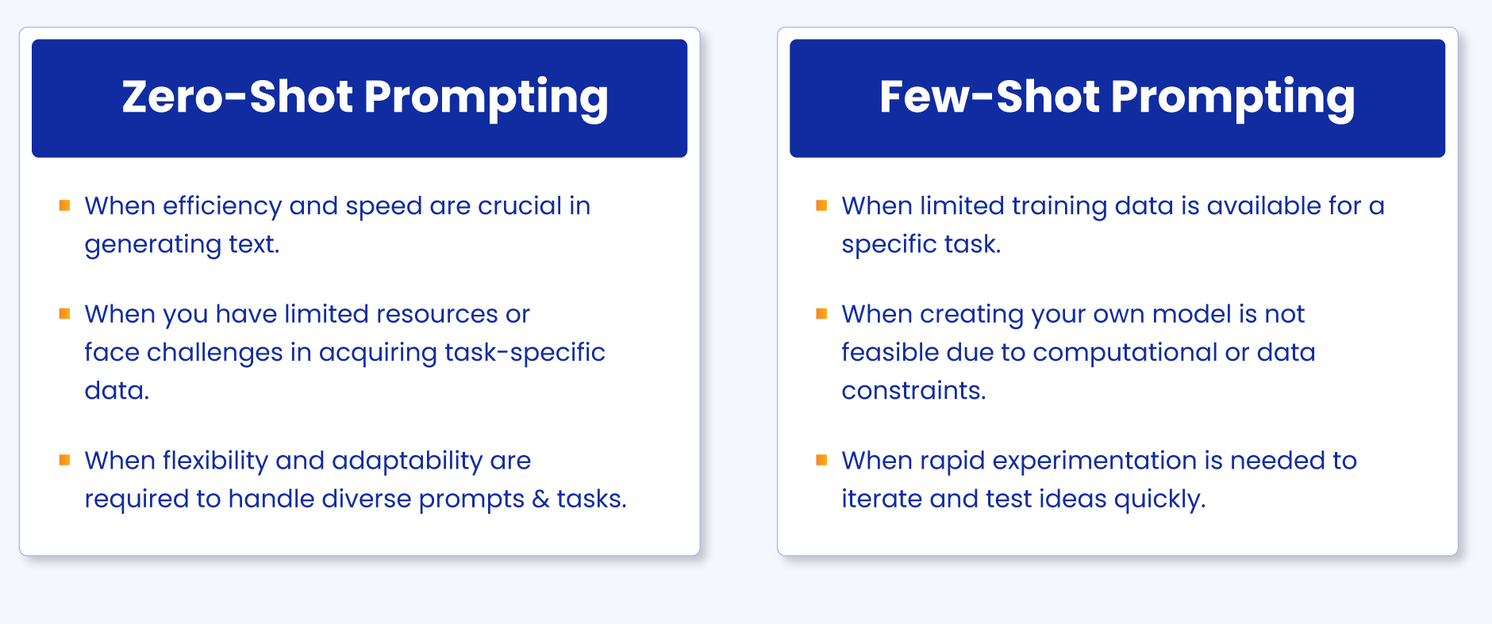
Prompting Types
Notes:
Examples: Few-shot prompting requires providing 2-3 relevant examples to guide GenAI's understanding of the desired style and tone. Zero-shot prompting doesn't require any examples, relying solely on the model's pre-trained knowledge.
Specificity: Few-shot prompting allows for more specific control over the output by providing concrete references. Zero-shot prompting offers less control as the model interprets the prompt based on its general understanding.
Performance: Few-shot prompting often leads to more accurate and relevant outputs compared to zero-shot prompting due to the additional guidance provided through examples.

Slide 82
Advanced Prompting Types
Advanced Types of Prompting
Few-Shot Chain-of-Thought Prompting
Zero-shot Chain-of-Thought Prompting (CoT)
Notes:
For more intricate tasks, consider advanced prompting techniques. Few shot Chain-of-thought prompting offers a glimpse into the AI's thought process, making it ideal for complex tasks that require reasoning. Zero-shot CoT achieves similar results without explicitly outlining the steps, allowing for a more natural flow.

Slide 83
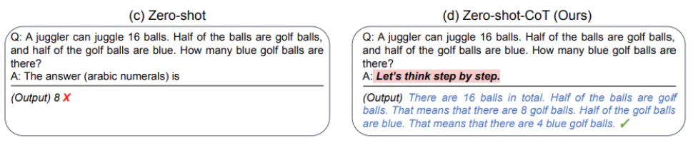
Advanced Prompting Types
Zero Shot CoT Prompting
Notes:
An approach proposed in zero-shot CoT (Kojima et al. 2022) refines zero-shot prompts by adding "Let's think step by step" to the original prompt.

Slide 84
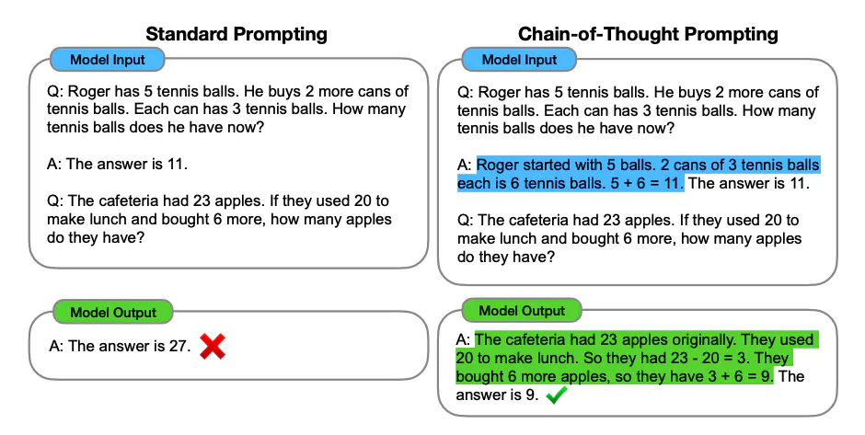
Advanced Prompting Types
Few Shot CoT Prompting
Notes:
Think of Few-Shot Chain-of-Thought Prompting as a way to train your AI with just a few well-chosen examples. Instead of overwhelming it with a mountain of data, we provide specific scenarios that illustrate the desired outcome. Additionally, we break down complex tasks into a series of logical steps, allowing the AI to reason its way through the process, just like a human would. This combination unlocks a new level of efficiency and transparency in AI.

Slide 85
Tips for effective prompting
Zero Shot Prompting
Be Clear and Specific
Provide Context
Set Parameters
Focus on the Task
Refine and Iterate
Notes:
The quality of the output depends heavily on the quality of the prompt we provide. By following these simple tips, we can ensure our prompts are clear, concise, and give GenAI the information it needs to deliver exceptional results. Let's take a look at a real-world example of how effective prompting can benefit managers. Imagine you need to create a social media post promoting a new product launch. You can use GenAI to generate different creative options based on your target audience and brand voice. By providing a clear and specific prompt, you can get a variety of compelling post options to choose from, saving you valuable time and effort.

Slide 86
Practical use cases and tools for leveraging GenAI

Slide 87
E-commerce & Marketing
Generate personalized product descriptions tailored to individual customer preferences.
Create dynamic marketing materials that resonate with target audiences.
Develop AI-powered chatbots for improved customer service and lead generation.
Optimize ad targeting and personalize ad content for maximum impact.
Automate social media content creation and save time and resources
Notes:
Generative AI can be a game-changer for e-commerce and marketing. Imagine product descriptions that speak directly to a customer's needs, or social media posts that feel custom-crafted for each follower. Generative AI can personalize the customer journey, leading to increased engagement and sales.

Slide 88
Media & Entertainment
Generate realistic special effects and characters for films and video games.
Create personalized music recommendations and playlists for streaming services.
Develop AI-powered scriptwriting and storyboarding tools.
Personalize content delivery based on user preferences and viewing history.
Generate trailers and teasers that capture audience attention.
Notes:
The world of entertainment is embracing Generative AI! Imagine creating lifelike characters for your next blockbuster film, or crafting personalized music experiences for each listener. Generative AI is injecting a new level of creativity and personalization into the media and entertainment industry.

Slide 89
Product Design & Development
Generate innovative product designs and prototypes based on user needs and market trends.
Optimize product features and functionalities for improved performance and user experience.
Automate repetitive tasks in the design process
Generate realistic product mockups and simulations for marketing and testing purposes.
Personalize product configurations based on customer preferences.
Notes:
Generative AI can be a game-changer for e-commerce and marketing. Imagine product descriptions that speak directly to a customer's needs, or social media posts that feel custom-crafted for each follower. Generative AI can personalize the customer journey, leading to increased engagement and sales.

Slide 90
Manufacturing & Supply Chain
Optimize production processes and predict potential bottlenecks in the supply chain.
Generate preventative maintenance schedules to minimize downtime and ensure smooth operations.
Personalize manufacturing processes for customized product creation.
Design and optimize packaging based on product characteristics and shipping requirements.
Analyze data to predict product demand and optimize inventory management.
Notes:
Generative AI can be a game-changer for e-commerce and marketing. Imagine product descriptions that speak directly to a customer's needs, or social media posts that feel custom-crafted for each follower. Generative AI can personalize the customer journey, leading to increased engagement and sales.

Slide 91
Healthcare & Pharmaceuticals
Generate synthetic medical data to protect patient privacy while enabling research.
Analyze medical images and data to support early disease detection and diagnosis.
Develop personalized treatment plans and predict patient outcomes.
Automate administrative tasks in healthcare settings, freeing up medical professionals for patient care.
Generate patient education materials tailored to individual needs and health literacy levels.
Notes:
The healthcare industry stands to benefit greatly from Generative AI. Imagine using AI-generated data to train medical algorithms without compromising patient privacy, or creating personalized treatment plans that take into account individual patient profiles. Generative AI has the potential to revolutionize healthcare delivery and improve patient outcomes.

Slide 92
Financial Services
Generate personalized financial reports and investment recommendations.
Analyze financial data to identify fraud and detect potential risks.
Automate repetitive tasks in financial services, such as loan processing and risk assessment.
Develop chatbots for customer service and wealth management assistance.
Create financial models and simulations to assess investment opportunities.
Notes:
Generative AI is making waves in the financial services sector. Imagine AI-powered tools that can provide personalized financial advice or analyze vast amounts of data to uncover hidden financial trends. Generative AI has the potential to streamline operations and empower individuals to make informed financial decisions.

Slide 93
Education and Training
Generate personalized learning materials tailored to individual student needs and learning styles.
Develop AI-powered tutors and chatbots to provide personalized learning support.
Analyze student data to identify areas for improvement and personalize instruction.
Automate administrative tasks in educational institutions
Create interactive simulations and virtual labs for enhanced learning experiences.
Notes:
Generative AI is transforming the education landscape. Imagine AI systems that can tailor learning materials to each student's strengths and weaknesses, or create immersive simulations that bring complex concepts to life. Generative AI has the potential to personalize education and make learning more engaging and effective.

Slide 94
Customer Service
Develop AI-powered chatbots for 24/7 customer support and lead generation.
Generate personalized responses to customer inquiries and complaints.
Analyze customer data to identify trends and improve customer satisfaction.
Automate repetitive tasks in customer service
Proactively address customer needs and concerns through AI-powered chatbots.
Notes:
Generative AI is revolutionizing customer service. Imagine chatbots that can answer customer questions with a human touch, or AI systems that can anticipate customer needs before they even arise. Generative AI can streamline customer interactions and enhance the overall customer experience.

Slide 95

Case Study 1 - IBM Watson Advertising
IBM Watson Advertising uses natural language processing (NLP) and machine learning (ML) to analyze customer data
Generative AI creates personalized ads in real-time
Traditional approach: manual ad creation, limited scalability
Benefits: increased ad relevance, improved customer engagement
Notes:
IBM Watson Advertising uses NLP and ML to analyze customer data and create personalized ads in real-time. This approach has increased ad relevance and improved customer engagement

Slide 96
Case Study 1 - IBM Watson Advertising
AI analyzes customer data to create targeted ads
Increased ad engagement by 25%
Improved customer satisfaction by 30%
Reduced ad spend by 15%
Notes:
By analyzing customer data, AI creates targeted ads that resonate with customers, leading to increased engagement and satisfaction

Slide 97
Case Study 1 - IBM Watson Advertising
Gen AI-powered ad creation reduces production time by 50%
Increased ad recall by 20%
Improved brand recognition by 15%
Enhanced customer experience through personalized ads
Gen AI-driven insights for optimized ad campaigns
Notes:
Not only do personalized ads perform better, but Gen AI also streamlines the ad creation process, reducing production time by 50%. This leads to increased ad recall, brand recognition, and customer satisfaction

Slide 98

Case Study 2 - Adidas - Generating New Shoe Designs
Adidas is a leading sportswear brand known for innovation.
Traditionally, designers relied on manual sketching and prototyping.
Time-consuming and limited design exploration possibilities.
Adidas utilizes generative AI to explore new shoe design concepts.
Designers can input design specifications like material, color, and function.
Gen AI generates a vast array of unique and creative design variations.
Notes:
Adidas embraced Gen AI to revolutionize its design process. Designers can now input specific design criteria, such as desired materials, color palettes, and functionalities. The Gen AI system then generates a vast array of unique and creative design variations, pushing the boundaries of design exploration and accelerating the innovation process.

Slide 99
Case Study 2 - Adidas - Personalized Marketing
Adidas used Gen AI to create personalized marketing campaigns
Gen AI analyzed customer data and preferences to create targeted ads
Increased customer engagement and conversion rates
Reduced marketing costs
Improved customer satisfaction
Notes:
By analyzing customer data and preferences, Adidas was able to create targeted ads that resonated with their audience, resulting in increased engagement and conversion rates

Slide 100
Case Study 2 - Adidas - Personalized Marketing
Gen AI helped Adidas reduce marketing costs by 30%
Increased customer satisfaction by 25%
Improved customer retention by 15%
Enhanced brand loyalty
Increased customer lifetime value
Notes:
The results were impressive: Adidas reduced marketing costs by 30%, increased customer satisfaction by 25%, and improved customer retention by 15%. This demonstrates the power of Gen AI in driving business outcomes."

Slide 101
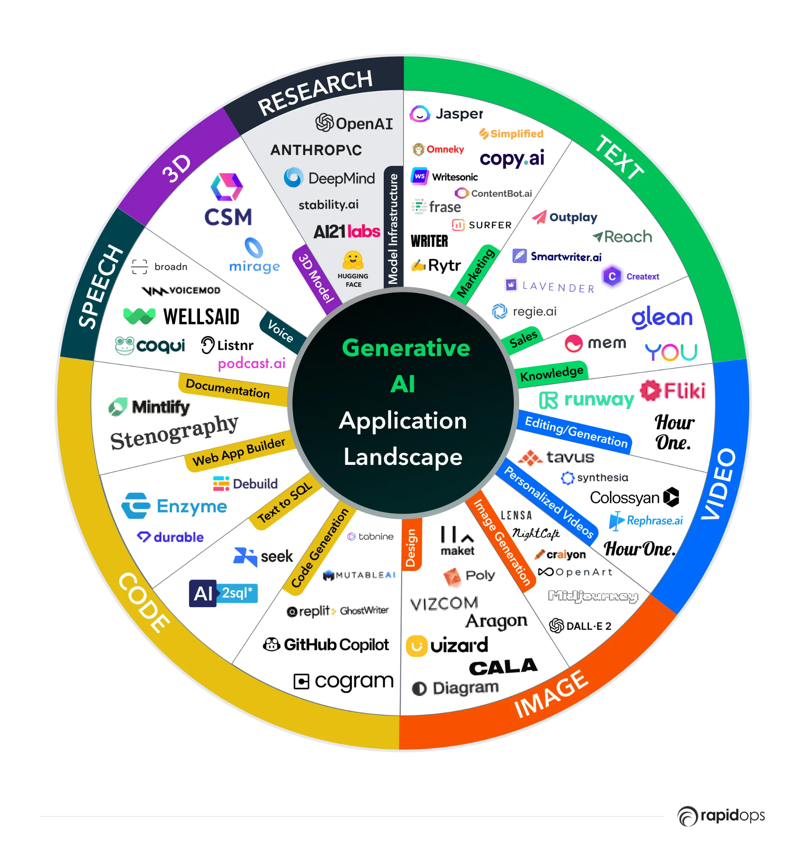
Top Generative AI tools
Notes:
Figure illustrates various Generative AI tools for various types of inputs.

Slide 102
Ethical Consideration of GenAI

Slide 103
Ethics in Generative AI Development
Bias and fairness
Deepfakes
Transparency and accountability
Privacy and security
Job displacement and workforce impact
Societal impact and responsibility
Notes:
Just like any powerful tool, GenAI demands our attention to ethical considerations. Unchecked, it could lead to biased outputs that discriminate against certain groups. Additionally, privacy concerns arise when GenAI uses personal data for content generation. By proactively addressing these issues, we can build trust with consumers and ensure GenAI's responsible development.

Slide 104
Principles of Ethical AI
Transparency
Fairness
Accountability
Privacy
Bias Mitigation
Human Oversight
Notes:
Transparency: AI systems should operate transparently, providing clear explanations of their processes and decision-making criteria to users and stakeholders. Transparency builds trust and enables informed decision-making.
Fairness: Ethical AI must strive for fairness and equity, ensuring that algorithms and models do not discriminate against individuals or groups based on factors such as race, gender, or socioeconomic status. Fair AI promotes inclusivity and diversity.
Accountability: Stakeholders should be accountable for the outcomes and impacts of AI systems. This includes taking responsibility for errors, biases, and unintended consequences, and implementing mechanisms for redress and improvement.
Privacy: Ethical AI respects individual privacy rights and data protection principles. It should minimize data collection, use secure and anonymized data practices, and uphold privacy regulations to safeguard user information.
Bias Mitigation: AI systems must actively mitigate biases in data and algorithms to ensure unbiased decision-making and outcomes. Bias mitigation strategies include data preprocessing, algorithmic fairness assessments, and ongoing monitoring.
Human Oversight: Human oversight and control are essential in AI development and deployment. Human judgment and intervention can help address ethical dilemmas, ensure compliance with ethical guidelines, and uphold ethical standards in AI systems.

Slide 105
Bias in Generative AI
Selection Bias
Stereotyping Bias
Confirmation Bias
Notes:
Selection Bias: Occurs when the training data does not represent the entire population, leading to skewed results.
Stereotyping Bias: Arises when AI models reinforce stereotypes based on race, gender, or other demographic factors.
Confirmation Bias: Occurs when AI systems prioritize information that aligns with pre-existing beliefs or preferences.

Slide 106
Data Bias: The Root Cause
Understanding Data Bias in Generative AI
Training data may reflect societal biases (race, gender)
Biased outputs: AI perpetuating existing inequalities
Importance of diverse & representative datasets
Notes:
Data bias is the root cause of many ethical concerns. If the data used to train a generative AI is skewed, the results will be skewed as well. Imagine an AI generating marketing content that reinforces gender stereotypes. We need to ensure our datasets are diverse and representative of the population we are targeting.

Slide 107
Mitigating Data Bias
Strategies to Address Data Bias in Generative AI
Data collection: Actively seeking diverse data sources
Data cleaning: Identifying and removing biased elements
Algorithmic fairness: Techniques to detect and mitigate bias
Notes:
We can't eliminate bias entirely, but we can mitigate it. Let's be proactive in collecting data from diverse sources. We can clean our data to remove existing biases. Additionally, there are algorithms specifically designed to detect and mitigate bias in AI models.

Slide 108
Mitigating Bias in Generative AI
Use diverse and balanced datasets for training AI models.
Develop techniques to identify and remove bias in training data.
Foster human oversight and intervention in the training process.
Implement fairness metrics to evaluate and mitigate bias in AI outputs.
Promote transparency in the development and use of generative AI models
Notes:
Bias is a major concern with generative AI. If the AI is trained on data that reflects societal biases, for example, racist or sexist data, it will churn out biased outputs. This can perpetuate discrimination and social injustices. To mitigate this, we need to ensure the datasets used to train AI models are diverse and balanced, representing a broad spectrum of people and perspectives. Additionally, we can develop techniques to identify and remove bias from the training data itself. Human oversight is also crucial. Involving humans in the training process can help identify and address potential biases before they become ingrained in the AI model. Furthermore, fairness metrics can be developed to evaluate the outputs of generative AI models and identify any biases. Finally, transparency is key. By being open about the development and use of generative AI models, we can foster trust and identify potential issues early on.

Slide 109
Accountability and Transparency
Importance of accountability in AI decision-making processes.
Need for transparent AI systems to enhance trust and understanding.
Role of explainable AI (XAI) in improving transparency and accountability.
Challenges in implementing accountability mechanisms in complex AI systems.
Ethical implications of opaque AI algorithms and decision-making.
Notes:
Accountability is crucial in AI development, ensuring that decision-making processes are traceable and accountable.
Transparent AI systems build trust among stakeholders by providing insights into AI algorithms and decision logic.
Explainable AI (XAI) techniques such as decision trees and model interpretability tools can enhance transparency in AI systems.
However, implementing accountability mechanisms in complex AI systems poses challenges due to algorithm complexity and data privacy concerns.
The ethical implications of opaque AI algorithms highlight the need for transparent and accountable AI practices.

Slide 110
Privacy and security
Generative AI models are often trained on massive datasets of personal information
Data privacy and security are paramount when using generative AI
Robust measures are needed to protect user data from unauthorized access or misuse
Notes:
Generative AI models are often trained on vast datasets containing personal information, such as text, images, and even voice recordings. This raises concerns about data privacy and security. We need to ensure that user data is collected, stored, and used responsibly. Robust security measures must be in place to protect data from unauthorized access or misuse.

Slide 111
Social Impact and Responsibility
Generative AI's potential to shape societal norms and cultural narratives
Ethical implications of AI-generated content on misinformation and trust
Corporate responsibility in promoting ethical use and mitigating harmful impacts.
Balancing innovation with ethical considerations to foster public trust.
Collaborative approaches for addressing societal challenges through AI advancements.
Ensuring inclusivity and diversity in AI development to avoid biases and discrimination
Notes:
The slide focuses on the broader social impact of Generative AI, touching on issues like bias amplification, job displacement, and the ethical use of AI-generated content. It highlights the dual role of businesses in innovation and social responsibility, emphasizing the need for collaborative efforts to navigate ethical challenges effectively.

